Slide 1
Physics in Circuits and Gadgets (part 3)

Slide 2
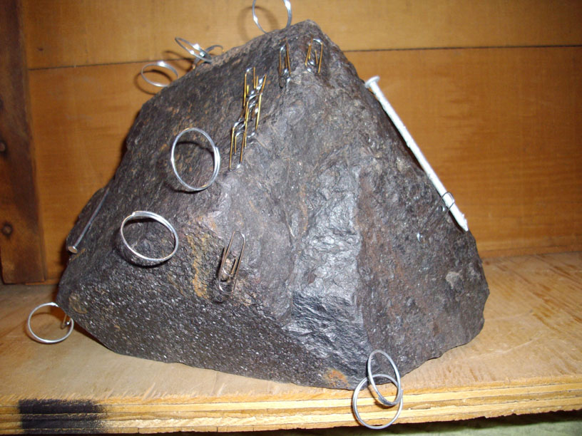
Magnet
A magnet is a material or object that produces a magnetic field.
Lodestone
http://en.wikipedia.org/wiki/Magnet

Slide 3
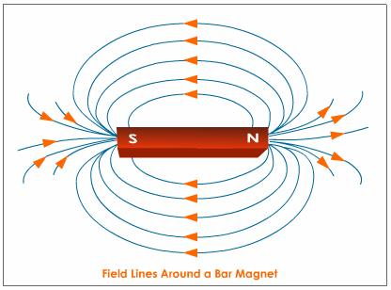
Magnetic Poles
North Pole
South Pole

Slide 4




Unlike poles attract, like poles repel
http://www.howmagnetswork.com/

Slide 5
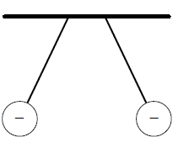
Charges vs. Magnets
Charges interact with other charges (Electrostatic force)
Magnets interact with other magnets
(Magnetic force)
Note: Force is the measure of the amount of interaction

Slide 6
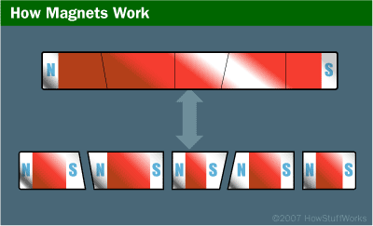
Magnets are dipoles
http://science.howstuffworks.com/magnet1.htm

Slide 7
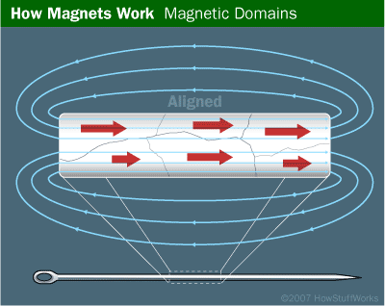
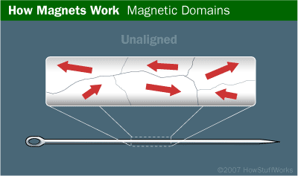
Magnetic Domains
http://science.howstuffworks.com/magnet1.htm

Slide 8
Magnetic Field
The space in which magnetic force is exerted.
Unit of Magnetic field intensity (B): tesla (T), gauss (G)
www.tutorvista.com

Slide 9
Magnetic field lines
Magnetic lines of force originate from the North Pole and end at its South Pole.

Slide 10
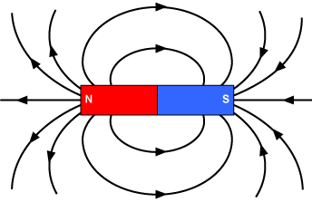
Magnetic field lines
The magnitude of the magnetic field is proportional to the magnetic field line density .
The line density near the poles is higher than at points away from the poles.

Slide 11
Magnetic field lines
The magnetic lines of force do not intersect (or cross) one another.

Slide 12

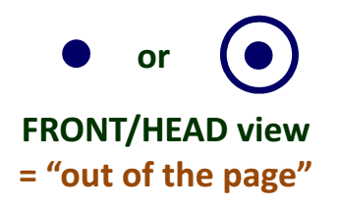
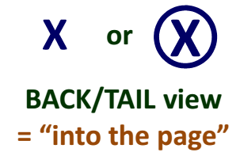
Magnetic field line direction

Slide 13
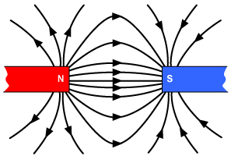
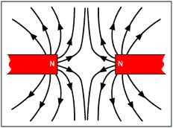
Magnetic Field Lines

Slide 14
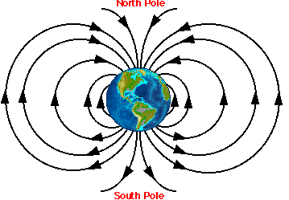
Earth produces magnetic field
www.unc.edu

Slide 15
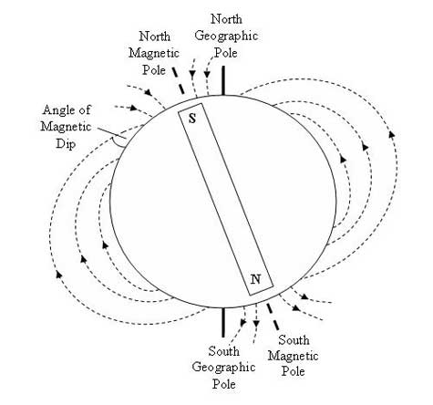
Earth produces magnetic field
www.acecrc.sipex.aq

Slide 16
Compass
a magnetic needle that can spin freely and will line itself up with the Earth’s magnetic field
(if there are no stronger magnetic fields nearby).
Note: Magnets interact with other magnets

Slide 17
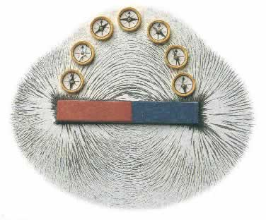
Magnetic Field Lines
magnetic compass aligns itself with the magnetic field

Slide 18
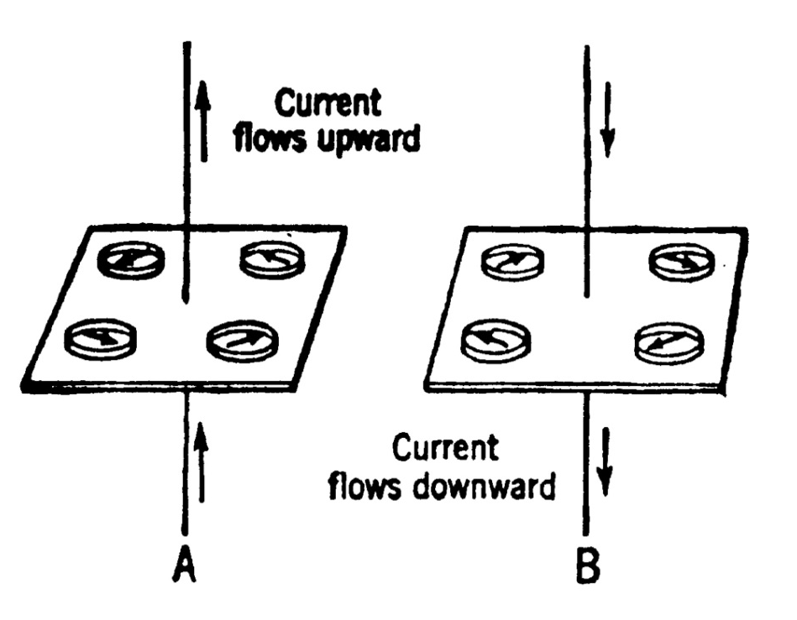

Source of Magnetic Field
Moving charges (current) produce magnetic field (e.g., current in wires or current in atomic orbits)

Slide 19
Oersted’s Observation
A pivoted magnet (a compass needle) was deflected when in the neighborhood of a wire carrying a current.

Slide 20
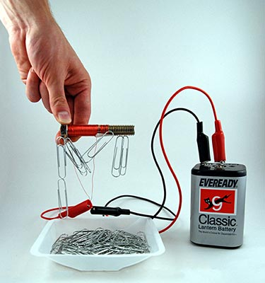
Electromagnets
produce magnetic fields when electricity travels through their wire coils.
www.sciencebuddies.org

Slide 21
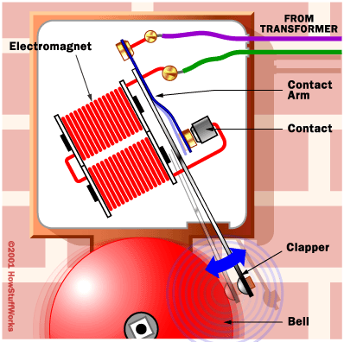
Ringing Bell

Slide 22
Magnetic force
a moving charge can experience magnetic force (F) if placed in a magnetic field (B)
v = velocity of the charge
q = charge

Slide 23
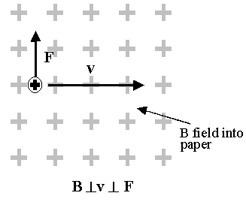
Magnetic force, F
A charge will experience magnetic force if
It is moving (current)
Its velocity has a component perpendicular to the direction of the magnetic field

Slide 24
Magnetic force, F
if v is parallel or anti-parallel to B, then F = 0

Slide 25
Direction of Force
The magnetic force is perpendicular to both the velocity (v) of the charge (q) and the magnetic field (B)

Slide 26
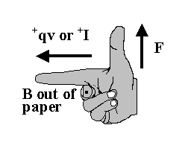
Direction of Force
Use right hand rule (#1)

Slide 27
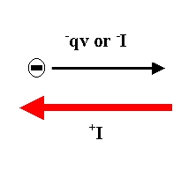
Right hand rule #1
Applicable for moving positive charges
In order to apply to a moving negative charge, the direction of the velocity must be reversed

Slide 28
Using your right-hand:
index finger : velocity (positive charge)
middle finger : magnetic field, B
thumb : magnetic force, F

Slide 29
Use the following:
East = right
West = left
North = front
South = back
Up
down

Slide 30
Exercise #1
Determine the direction of the magnetic force given the following:
1.) v = east, B = north
2.) v = north, B = east
3.) v = up, B = north
4.) v = north, B = east
5.) v = east, B = west
F = up
F = down
F = west
F = down
F = zero

Slide 31
Exercise # 2
Determine the direction of the magnetic force given the following:
1.) v = west, B = north
2.) v = north, B = up
3.) v = down, B = north
4.) v = north, B = north
5.) v = east, B = up
F = down
F = east
F = east
F = zero
F = south

Slide 32
Determine the direction of the magnetic force given the following:
1.)
v
2.)
v
B
“into”
B
F
F

Slide 33
Determine the direction of the magnetic force given the following:
3.)
v
4.)
v
“out”
B
B
F
F

Slide 34
Determine the direction of the magnetic force given the following:
5.)
v
6.)
v
“out”
B
B
“into”
F = 0
F = 0

Slide 35
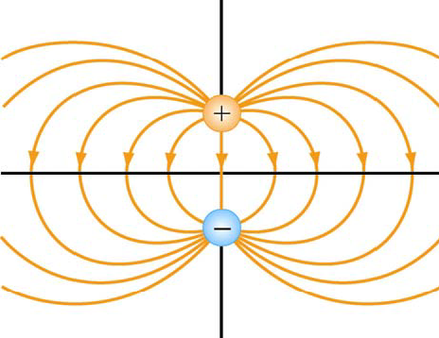
Electric field vs. Magnetic field
Positive to negative
North to South

Slide 36
Electric field vs. Magnetic field
magnitude of the field is proportional to the density of lines

Slide 37
Electric field vs. Magnetic field
The field do not intersect (or cross) one another.

Slide 38
direction of force and direction of field
Electric field
Magnetic field
Electrostatic force
Magnetic force
Same direction
Perpendicular

Slide 39
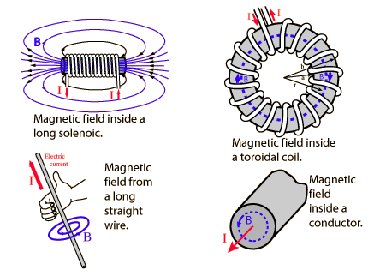
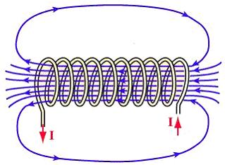
Ampere’s Law
Magnetic field (B) around an electric current is proportional to the electric current (I)

Slide 40
Ampere’s Law
solenoid
Toroidal coil
(Toroid)

Slide 41
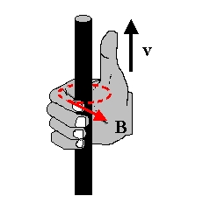
direction of the B around a current-carrying wire
Use right-hand rule (#2)

Slide 42
Right hand rule #2
thumb : direction of the current.
Curl your fingers into a half-circle around the wire, they point in the direction of the magnetic field, B
I

Slide 43
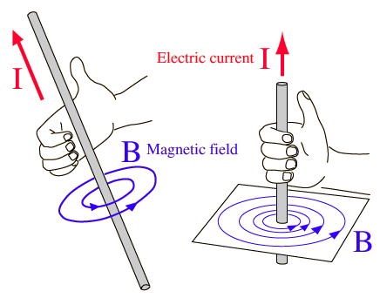
Current carrying wire
Applying the right hand rule

Slide 44
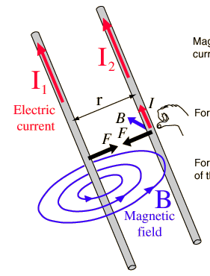
Force between current-carrying wires

Slide 45
Magnetic Flux (φ_{B})
Total amount of magnetic field (B) passing through a specific area (A)

Slide 46
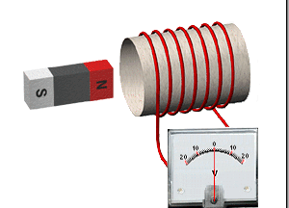
Faraday’s Law of Induction
Changing magnetic flux (with respect to time, t) produces voltage/electromotive force (EMF), electric field, current

Slide 47
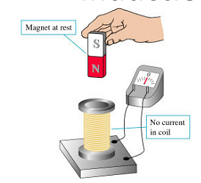
Faraday’s Law of Induction
Magnet at rest → no change in magnetic flux → no induced voltage/current

Slide 48
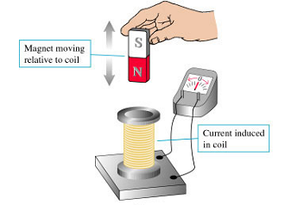
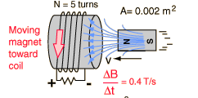
Faraday’s Law of Induction
Moving magnet→ changing the amount of B passing through a specific area (changing magnetic flux) → induced voltage/current

Slide 49
Lenz’s Law
The direction of any magnetic induction effect is such as to oppose the cause of the effect.
Notes:
‘s

Slide 50
Lenz’ Law
Clarifications:
negative
Magnetic field
Change in magnetic flux
Emf / voltage
current
opposing
Effect
Cause

Slide 51
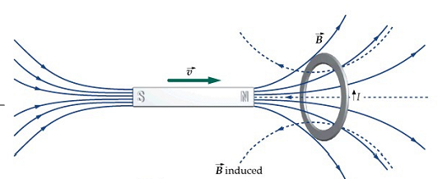
Lenz’s Law
Cause: ΔBA = increasing (+)
Effect: induced B → opposite direction to original B (-)
Note: “ΔBA” is different from “B”

Slide 52
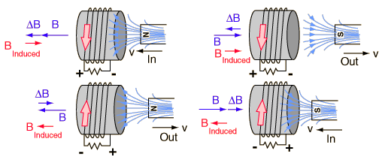
Lenz’s Law
Cause: ΔBA = increasing (+)
Effect: induced B → opposite direction to original B(-)
Note: “ΔBA” is different from “B”
Legend:
Direction of current

Slide 53
Lenz’s Law
Cause: ΔBA = decreasing (-)
Effect: induced B → same direction to original B(+)
Note: “ΔBA” is different from “B”
Legend:
Direction of current

Slide 54
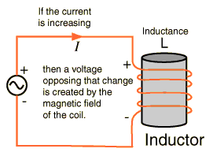
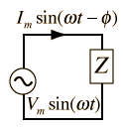
Alternating Current (AC)
AC - current constantly changing with time

Slide 55
Inductance, L
property of a conductor by which a change in current (ΔI) in the conductor induces (or creates) a voltage in both the conductor itself or in any nearby conductors.
Unit: Henry

Slide 56
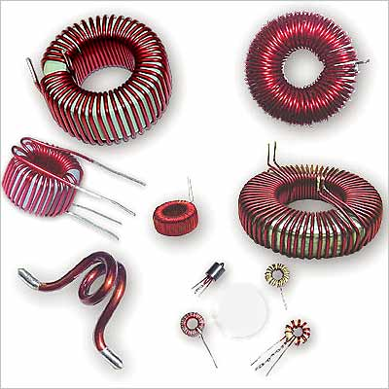
Inductor

Slide 57
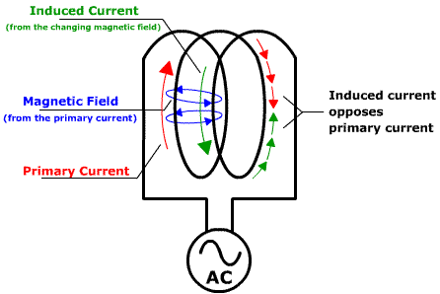
Self-Inductance
Changing current (ΔI) produces changing magnetic field (ΔB) that induces voltage (V_{induced}) and current (I_{induced}) to itself.
ndt-ed.org

Slide 58
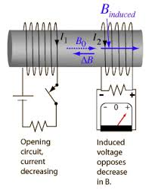
Mutual Inductance
Changing current (ΔI) produces changing magnetic field (ΔB) that induces voltage (V_{induced}) and current (I_{induced}) to other coils.

Slide 59
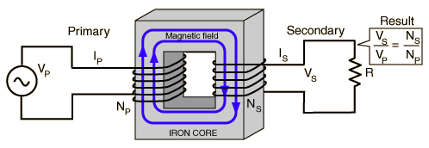
Mutual Inductance
Transformers → Voltage converters
Induced voltage
Source voltage

